Slide 1


Lecture 2:
Data Visualization
and Manipulation
McGill Artificial
Intelligence Society

Slide 2
Today’s Agenda
General overview and context of ML
Machine Learning Pipeline Overview
Data Manipulation
Data Visualization

Slide 3
General Overview And Context

Slide 4
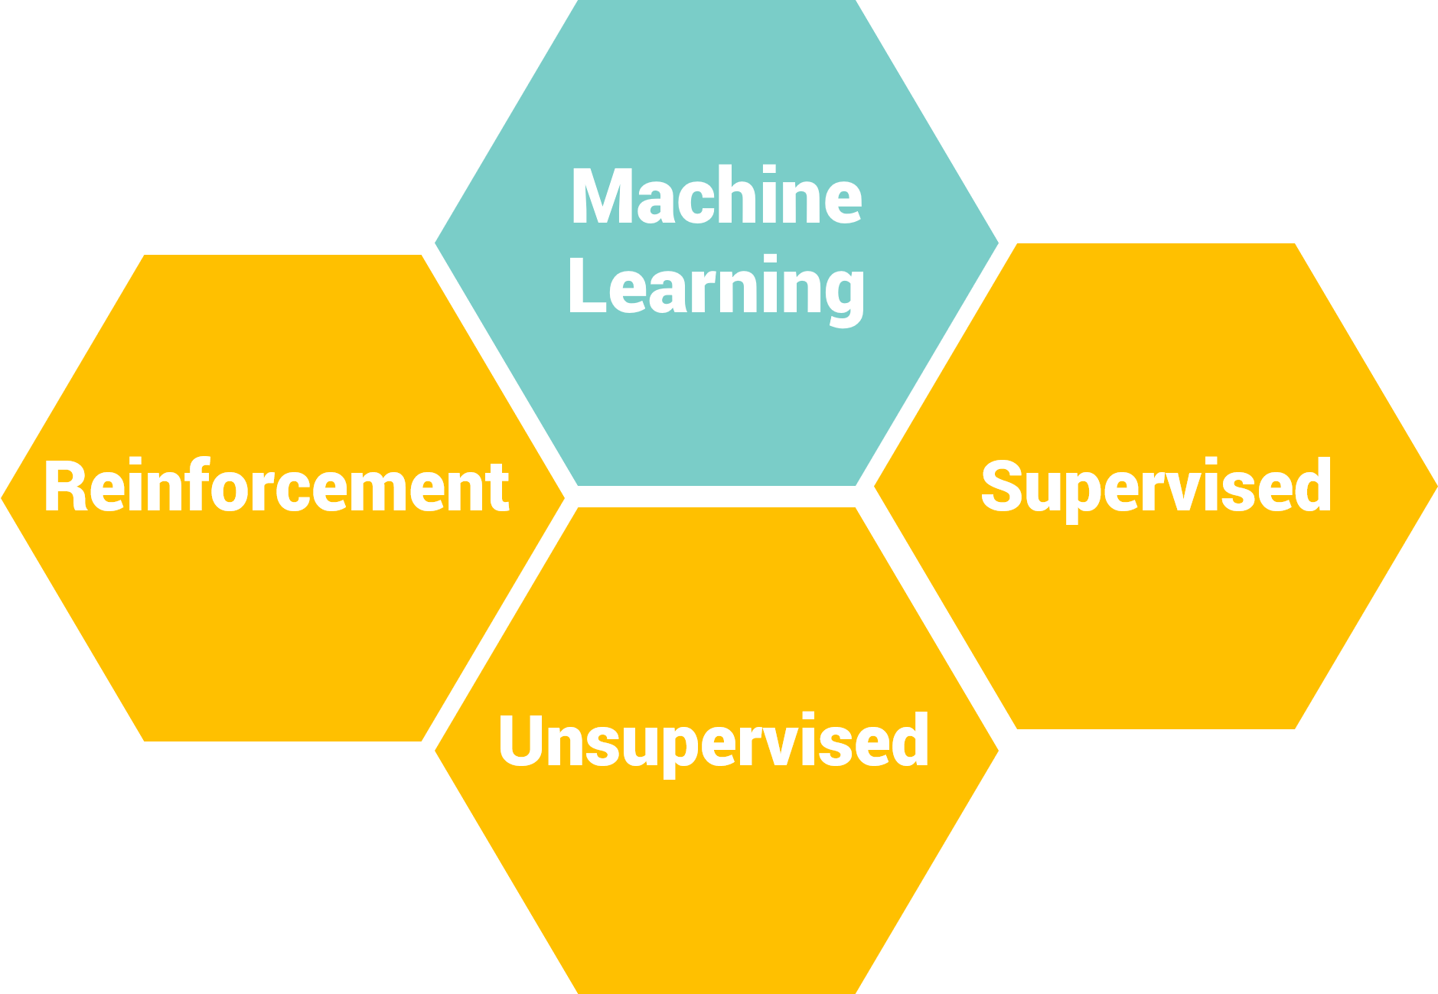
3 different classes of machine learning problems
Notes:
Supervised: the system is given features and labels, and the system attempts to map the function between features and labels - predictive analytics
Unsupervised: the system is given features and NO labels, and outputs “patterns” found in the features (e.g. k-means clustering, GMMs) - descriptive analytics
Reinforcement: are more complex, involves statistical models that evolve over time, and depends on data that is temporally correlated. We want to prescribe action a that will guarantee a reward r. Prescriptive analysis consumes new data about an uncertain and evolving environment, makes predictions, and uses these predictions to impact the world. However, the feedback connections between reward r and action a are very difficult to understand, and mistakes can lead to catastrophic results (e.g. self-driving cars)

Slide 5
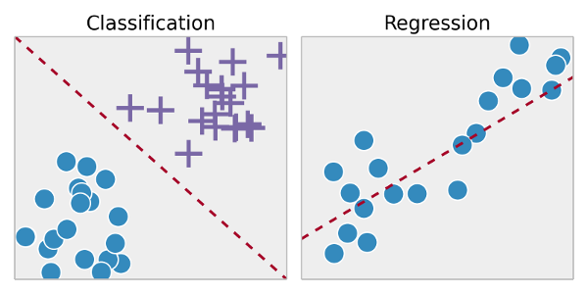
1 - Supervised Learning
Train your model to map the input to the prediction output based on the ground truth labels in the training data
Classification
Regression
Learning a function for a continuous output
Eg. Predicting sales price of house.
Learning a function for a categorical output
Eg. Classifying cats vs dogs in images.

Slide 6
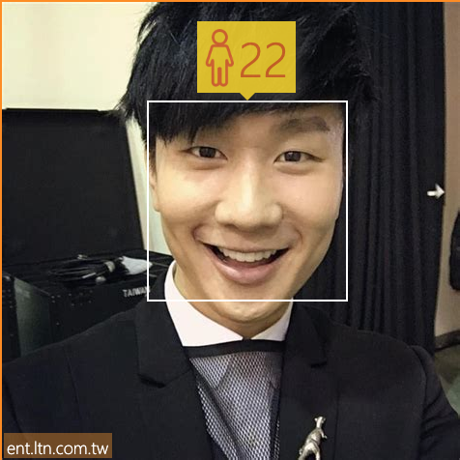
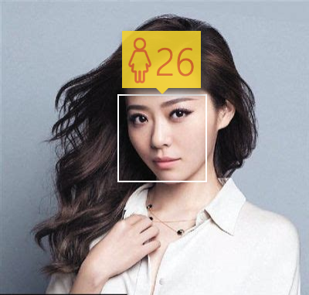
Regression
Gives a continuous output.
Example: Age Prediction
《红秀》杂志封面

Slide 7
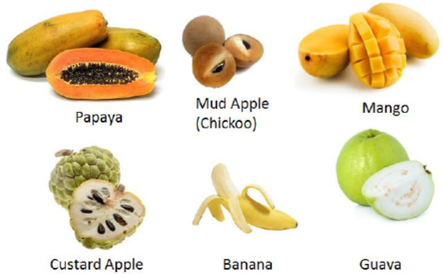
Classification
Gives a discrete output.
Example: Fruit Classification

Slide 8
Some Basic Terminology
Target Variable
Features/ Attributes
Colour | Mass | Shape | Seeds | Country | Fruit
Red | 100g | Round | Yes | Canada | Apple
Yellow | 647 g | Curved | No | Australia | Banana
Features / attributes: how you would describe the fruit
Target variable: how you want to teach your model to recognize the fruit. (ground truth)
Notes:
Prediction model, dataset

Slide 9
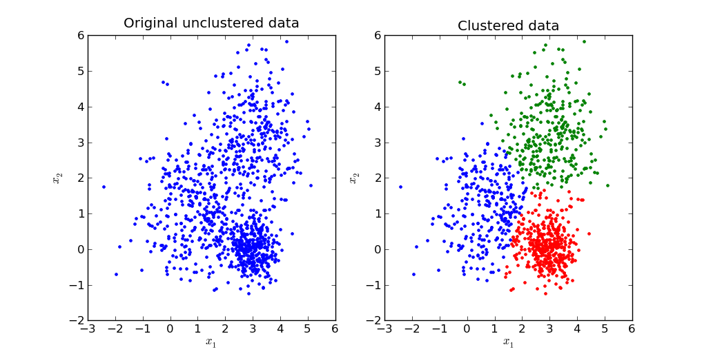
2 - Unsupervised Learning
Train your model to learn how to difference input data, and make prediction on its own without training labels.

Slide 10

3 - Reinforcement Learning
Your system learns to behave in an evolving environment and make prediction by learning from the outcome of specific actions.
Goal: learn the actions (Good) that maximize the reward.
Notes:
Prescriptive analysis consumes new data about an uncertain and evolving environment, makes predictions, and uses these predictions to impact the world. However, the feedback connections between reward r and action a are very difficult to understand, and mistakes can lead to catastrophic results (e.g. self-driving cars)

Slide 11

Example of Reinforcement Learning
Notes:
https://www.youtube.com/watch?v=V1eYniJ0Rnk - download the video

Slide 12
Machine Learning Pipeline

Slide 13
Machine Learning Pipeline
1 Identify Problem
Carefully define the problem you want to solve. What specific question are you trying to answer?
2 Gather Data
Figure out what data is needed and where to retrieve it. Does similar data exist or do we need to generate it?
3 Process Data
Format data that can be interpreted by a computer. That includes cleaning, manipulating and extracting important features to feed into the training model.
4 Train Model
Training the dataset on your selected model. In practice, datasets are split into train, validation and test sets in order to measure model performance.
5 Evaluate Results
Does the trained model solve your initial problem? Does it satisfy your performance requirements?
6 Repeat!
Improve your model by reiterating the process!

Slide 14
Machine Learning Pipeline
1 Identify Problem
Carefully define the problem you want to solve. What specific question are you trying to answer?
2 Gather Data
Figure out what data is needed and where to retrieve it. Does similar data exist or do we need to generate it?
3 Process Data
Format data that can be interpreted by a computer. That includes cleaning, manipulating and extracting important features to feed into the training model.
4 Train Model
Training the dataset on your selected model. In practice, datasets are split into train, validation and test sets in order to measure model performance.
5 Evaluate Results
Does the trained model solve your initial problem? Does it satisfy your performance requirements?
6 Repeat!
Improve your model by reiterating the process!

Slide 15
Identifying Problem
What are you trying to solve?
Example: IMDB (very famous dataset) - Predict movie ratings from reviews?
What kind of information are you trying to find out and based on what data?
What type of problem is it?
Classification, regression, clustering, etc?
What is your input?
Text, pictures, tabular data, numerical, etc.

Slide 16
Machine Learning Pipeline
1 Identify Problem
Carefully define the problem you want to solve. What specific question are you trying to answer?
2 Gather Data
Figure out what data is needed and where to retrieve it. Does similar data exist or do we need to generate it?
3 Process Data
Format data that can be interpreted by a computer. That includes cleaning, manipulating and extracting important features to feed into the training model.
4 Train Model
Training the dataset on your selected model. In practice, datasets are split into train, validation and test sets in order to measure model performance.
5 Evaluate Results
Does the trained model solve your initial problem? Does it satisfy your performance requirements?
6 Repeat!
Improve your model by reiterating the process!

Slide 17
Gathering Data
Does the dataset exist?
There exist a lot of common dataset centers:
UCI Machine Learning Repository
Kaggle
Find more here
Does it have what you need and relevant information to problem?
How can we get more data if needed?
Generate your own data (eg.: Take 1000 dog pictures on your own)
Augment data (especially in Computer Vision)
Private vs. public datasets

Slide 18
Machine Learning Pipeline
1 Identify Problem
Carefully define the problem you want to solve. What specific question are you trying to answer?
2 Gather Data
Figure out what data is needed and where to retrieve it. Does similar data exist or do we need to generate it?
3 Process Data
Format data that can be interpreted by a computer. That includes cleaning, manipulating and extracting important features to feed into the training model.
4 Train Model
Training the dataset on your selected model. In practice, datasets are split into train, validation and test sets in order to measure model performance.
5 Evaluate Results
Does the trained model solve your initial problem? Does it satisfy your performance requirements?
6 Repeat!
Improve your model by reiterating the process!

Slide 19
Machine Learning Workflow in Practice
Common misconceptions on what’s popular vs what’s more practical in research and industry
In the “wild”: massive, unstructured datasets
In industry and even in research, problems can be very ambiguous
Problems can be very ambiguous, so the first step is to take a look at your available data and to analyse what you can do with it.
This is so important that we will spend the rest of today on becoming experts at analyzing data.
Notes:
So there are common misconceptions on what’s popular vs what’s more practical, so I’ll say it right here: it’s not always about complicated models. Being able to make your features more interpretable to your prediction model can go a long way. I do want to add though, that in some cases, feature extraction has been done using things like autoencoders or convolutional layers in image processing, but a simple data visualization can sometimes give insight on what features to use.
Problems can be very ambiguous: since they can be very ambiguous, the first step to take is to take a look at your available data, and to analyze what exactly you can do with it. So what do we look for when examining data? (Slide)

Slide 20

Study Your Data
So you know what you can do with it
Notes:
(Ask audience if they have any questions so far, take 2) (Slide)

Slide 21
What to Look For? Data/Feature Exploration
A few examples:
Number of samples per class (class imbalance)
Gender analysis: 80% male vs. 20% female samples
Number of total samples in dataset (choosing models)
Neural networks generally require more training data
Number of features (dimensionality)
Categorical vs numerical features
Feature dependency
Missing features (average, median, etc.)
Not all rows (samples) have complete data
Notes:
So, to decide what preprocessing techniques to run on our data, naturally, we have to investigate what our data looks like, then deal with it accordingly. So here a few things to look for when investigating datasets:
The number of samples per class. So this applies to classification tasks mostly, and consider the following example: you’re given a dataset of credit card transactions, and you have two classes of samples- fraudulent and normal transactions. After running a model on your training set, you get an accuracy of 98%. So you’ve built an amazing classifier right? Not really… so what if 98% of samples in the dataset were normal transactions, while only 2% of your dataset consisted of fraudulent samples. So, knowing how balanced your classes are is important, both for measuring performance, as well as knowing if you need additional data.
Then, the total number of samples in a dataset is important, as well as the number of features per sample, because both those factors would help determine what algorithm, or model is best-suited for your task.
Also, categorical features cannot directly be interpreted by our prediction model, so we need to find a way to “encode” those features, as you’ll see shortly in our coding tutorial.
So in terms of feature dependency, for example, if one feature is a simple scalar multiple of the other, then we can say one of these features is redundant, so we don’t select one of them. Every feature we feed into our model is associated an importance, or a “weight”, so we want to avoid feeding redundant features.
Finally, we have to deal with missing features. Depending on the problem, we use different techniques, sometimes filling missing values with the median value for that specific feature, average. (Slide)

Slide 22
Goal of Preprocessing
Improve overall model performance
Reduce noise by removing unnecessary / noisy data
Improve interpretability
Reduce memory / time loads
Can save significant compute time / resources
Very crucial in machine learning (especially deep learning)
Data preprocessing can substantially change the outcome of your model
Notes:
Essentially, we want to do 3 things. The first, most obvious one, is to improve the overall model performance! This is done by making the data more “interpretable” to the machine. Second of all, if we reduce the feature space by getting rid of unimportant features, we don’t have to process on as much data, and this would save us both time, and memory, which in machine learning, is huge.
(Ask audience questions)
So now, we’ll go over a practical example of data preprocessing (Slide)

Slide 23
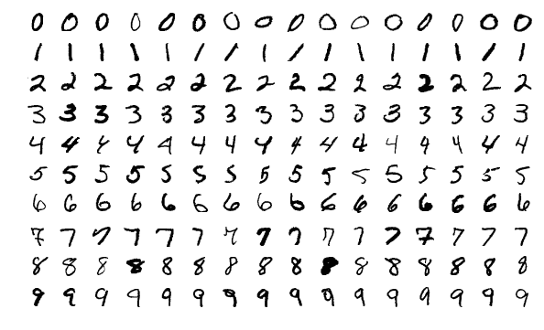
Example
Modified MNIST (Handwritten Digits)
The original dataset
Notes:
we see that most of the samples are relatively clean, each digit is written in black on a white frame of the same size, and for the most part, they don’t seem to be skewed or rotated. (Slide)

Slide 24
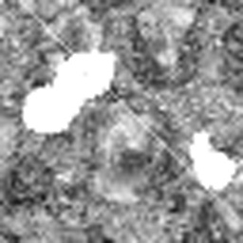



Example
Modified MNIST (Handwritten Digits)
Raw Pixel value threshold ROI selection Deskew
Notes:
For those who have taken COMP 551, first of all, what are you doing here? So this is a modified digits dataset that we had to work on. So if we take a raw sample, we can see that there are a few differences between a sample here, and a sample from the previous dataset. The raw data looked like first image on the left, where we had two digits per image, which were of different size, rotated, and surrounded by background noise. How could we process this data such that we could classify the largest digit in each sample?
So the first thing we could do, for example, is to set a threshold value: if pixels were above a certain value, they’d be white, and if they were under and certain value, they’d be black.
Second of all, since we only want to classify one digit, we could compute the contour of each digit and cut out the largest digit in the image.
Finally, in order to make it even easier for the model to classify digits, we could rotate the image such that each digit is aligned the same way.
All of that was done using the OpenCV library, which is an open-sourced computer vision library in Python. So now that we’ve seen a few examples and applications, we’ll take a two minute break and go through the coding tutorial, so get your Jupyter Notebooks ready.

Slide 25
Jupyter Notebook

Slide 26
At a quick glance
Open-source web app that allows you to create and share documents with:
Live code
Equations
Visualization
Text
Most importantly, runs in Python
jupyter notebook
localhost:8888 (default port)
Notes:
Followed by a quick demonstration of what is jupyter notebook

Slide 27
Data Visualization
Study your data to boost the design of your model.
Notes:
Good way to study your data

Slide 28

Introduction to
Open source data manipulation and analysis library for the Python.
Super easy to use!
import pandas as pd

Slide 29
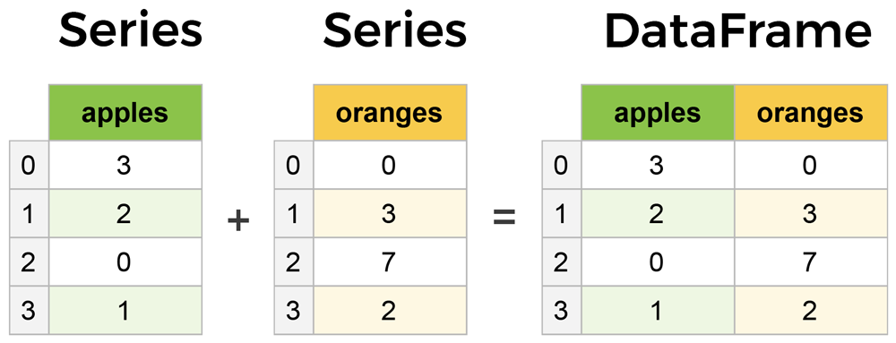
Pandas Series and DataFrame
Picture from LearnDataSci

Slide 30
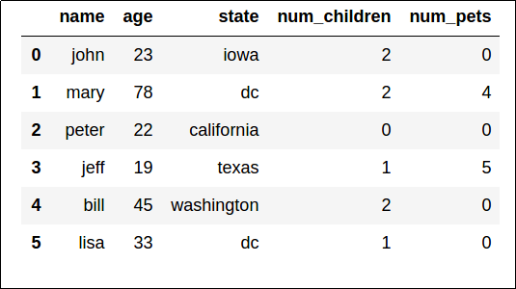
Pandas DataFrames
2D labeled data structure with columns of potentially different types.
Numerical DataFrame can easily be converted to numpy arrays.

Slide 31
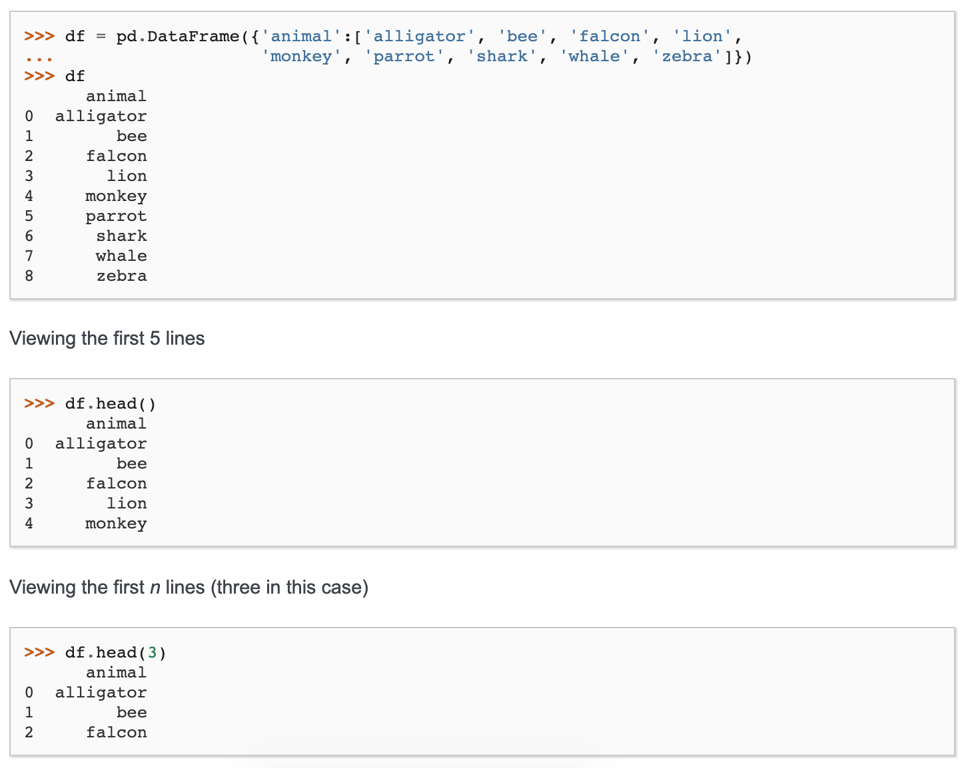
Basic Pandas Commands
Create dataframe and show first few rows
Notes:
Pandas - Essential Basic Functionality Documentation

Slide 32
Basic Pandas Commands
Show first few rows
Notes:
Pandas - Essential Basic Functionality Documentation

Slide 33
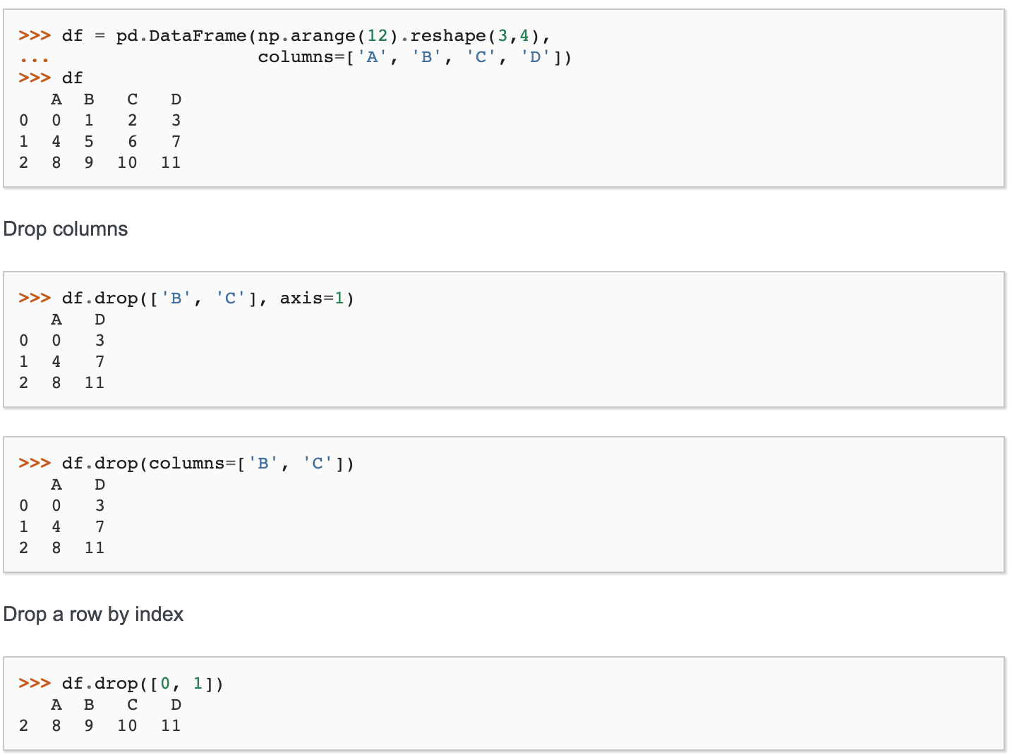
Basic Pandas Commands
Create your dataframe from numpy arrays and name the columns
Notes:
Pandas - Essential Basic Functionality Documentation

Slide 34
Basic Pandas Commands
Dropping columns
Drop a row by column name
Drop a row by index
Notes:
Pandas - Essential Basic Functionality Documentation

Slide 35
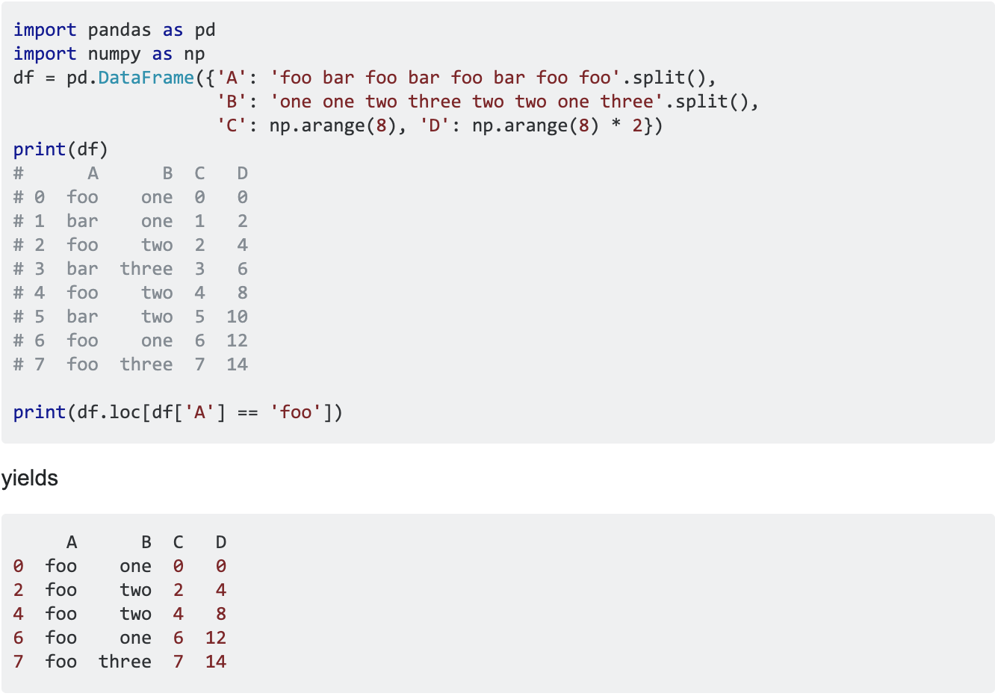
Basic Pandas Commands
Selecting rows with specific values
Notes:
Pandas - Essential Basic Functionality Documentation

Slide 36
Many more commands including...
Concatenate tables together
Perform statistical analysis
Filling missing data
Table-wise / column-wise analysis
Arithmetic computations
Read and write files from your computer
Creating subtables
Group data per criteria
Etc.

Slide 37

Introduction to
Plotting library for the Python programming language and its numerical mathematics extension NumPy
Super easy to use!
import matplotlib.pyplot as plt

Slide 38
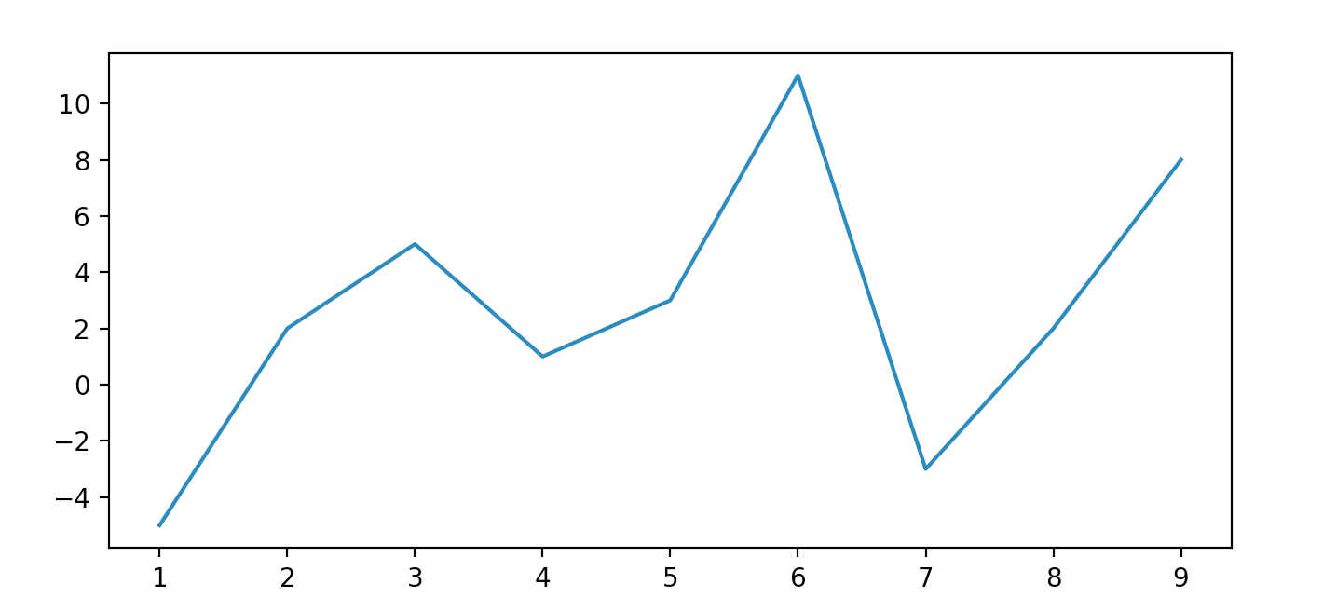
import numpy as np
import matplotlib.pyplot as plt
x = np.array([1, 2, 3, 4, 5, 6, 7, 8, 9])
y = np.array([-5, 2, 5, 1, 3, 11, -3, 2, 8])
plt.plot(x, y)
plt.show()

Slide 39
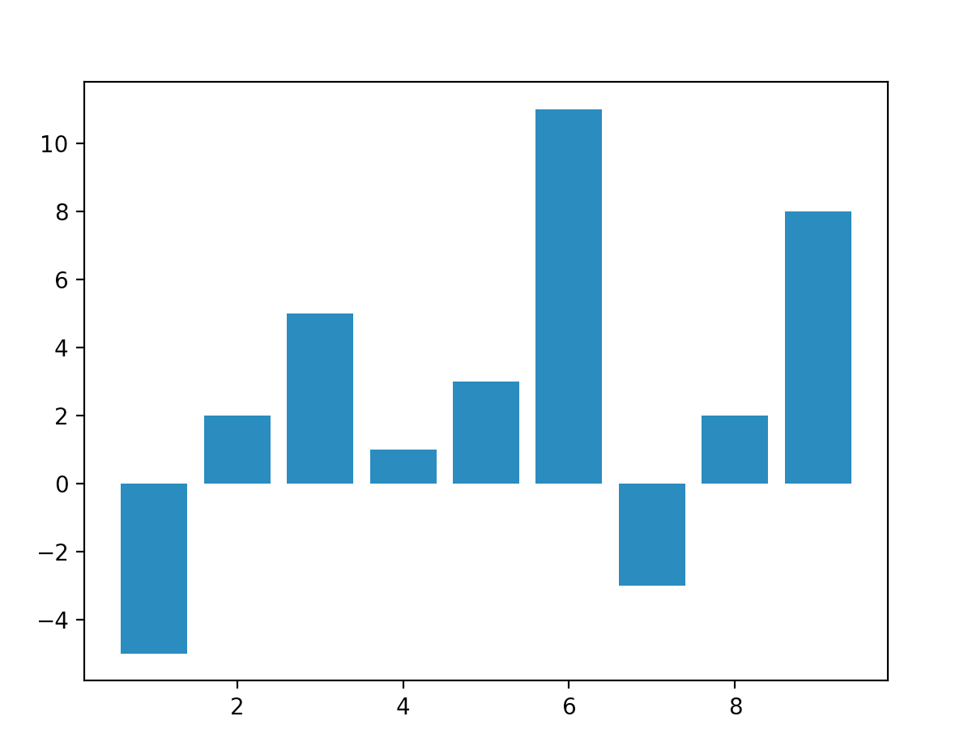
import numpy as np
import matplotlib.pyplot as plt
x = np.array([1, 2, 3, 4, 5, 6, 7, 8, 9])
y = np.array([-5, 2, 5, 1, 3, 11, -3, 2, 8])
plt.bar(x, y)
plt.show()

Slide 40
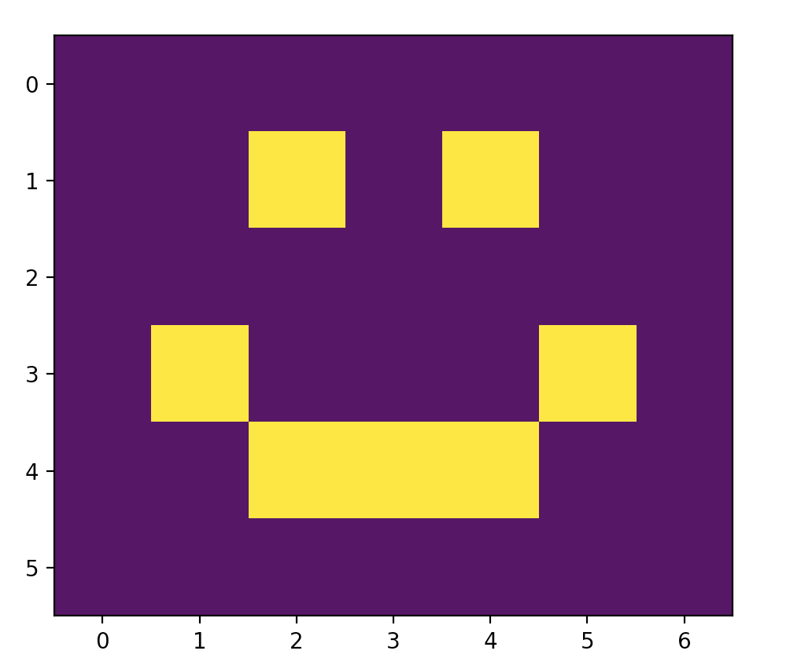
x = np.array([[0, 0, 0, 0, 0, 0, 0],
[0, 0, 1, 0, 1, 0, 0],
[0, 0, 0, 0, 0, 0, 0],
[0, 1, 0, 0, 0, 1, 0],
[0, 0, 1, 1, 1, 0, 0],
[0, 0, 0, 0, 0, 0, 0]])
plt.imshow(x)
plt.show()

Slide 41
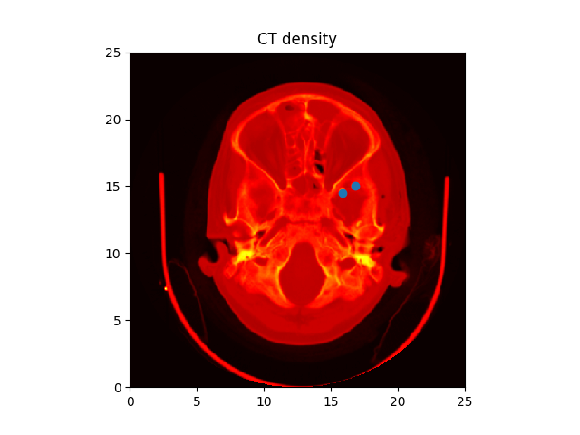
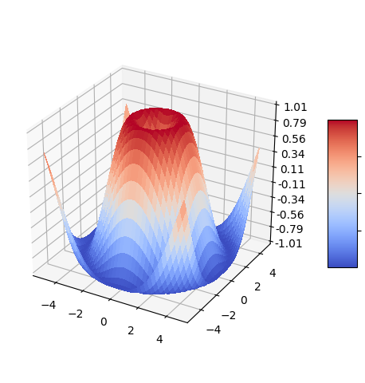
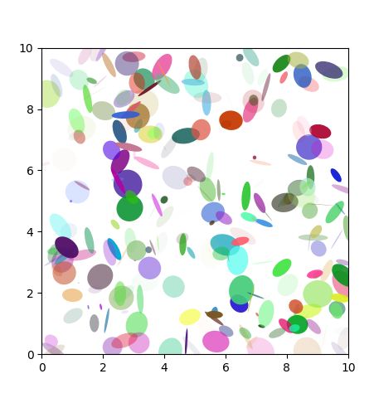
Matplotlib is a great tool data visualization
Some examples from their website
matplotlib - pyplot demo
matplotlib - 3D surface (color map)
matplotlib - Ellipse Demo

Slide 42
Homework Assignment
Practice data visualization and manipulation.
Assignment2-DataVisualizationAndManipulation.ipynb
Notes:
https://www.w3resource.com/python-exercises/numpy/linear-algebra/numpy-linear-algebra-exercise-1.php

Slide 43
Thanks!
Any questions?
McGill Artificial
Intelligence Society

